Slide 1
Consumer Privacy and
Information Access
CIS 150: Fundamentals of Information Systems

Slide 2
Last Classes
Intellectual Property in Cyberspace
  What is Intellectual Property?
  How has IS affected issues related to IP?
    Digital files, MP3 file-compression format, high-volume, cheap digital storage media, scanners, WWW, broadband (high-speed) Internet connections, peer-to-peer (P2P) networks vs. client-server architecture, software tools for manipulating content
  What are the different types of IP protections?
    Copyrights, patents, trade secrets, and trademark
  How can we compare/contrast these types of IP protection?
  What are the sets of copyright laws related to the Internet?
  How have the courts interpreted these laws with respect to computer software and digital music, movies, and videos?

Slide 3
Last Classes
Revisited and reviewed
  Betamax Case (seminal fair use case related to contributory infringement)
  DMCA
Solutions (other than CR laws) to the IP problem
  Technology-based solutions (encryption, DRM)
  Market-based solutions (new business models)
  Social norms-based solutions (taxation)
  Other legal IP protections (patents, trademarks, and trade secrets)
Is a top-down approach or a bottom-up approach more effective?
Open Source Software
  Should we forget about all of this? Should all software be free?

Slide 4
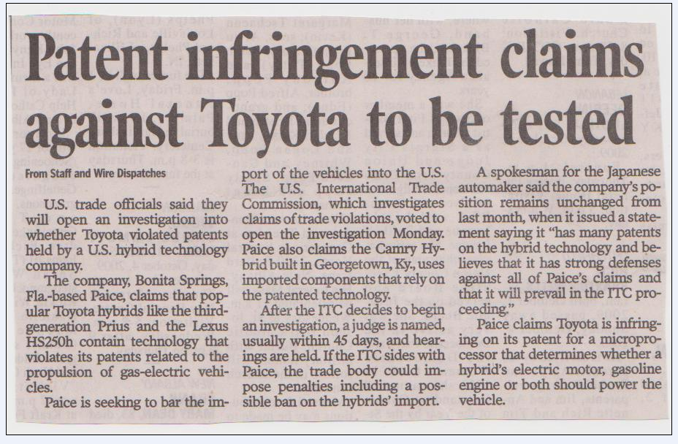
IT-Based Patents
(A Recent Example)
The Courier-Journal (Wednesday, October 7, 2009, p. B6)

Slide 5
Trade Secrets
(A Recent Example)
Craig, S., Efratis, A., “Ex-Goldman Worker is Arrested,” WSJ, July 7, 2009, p. C3
  Background
    Sergey Aleynikov was a Goldman Sachs computer programmer ($400,000/year) between May 2007 and June 2009 before moving to start-up automated trading firm Teza Technologies
    At Goldman, Aleynikov signed a standard confidentiality pact requiring him to handle all non-public information "in strict confidence“ and to return any non-public documents obtained while working at Goldman upon his departure
    Before he left Goldman he allegedly stole 32 megabytes of proprietary code related to a high-speed trading application that he helped to develop
    He copied the code from his work computer to a server in Germany
    Goldman found out about the IP leak when monitoring data uploads from its system

Slide 6
Trade Secrets
(A Recent Example)
Goldman Sachs case
  Accusation
    On July 3 the FBI arrested Aleynikov and charged him with "theft of trade secrets" with "the intent to convert that trade secret to the economic benefit of someone other than the owner." (bail was set at $750,000)
      Goldman says that
        If its competitors get hold of the proprietary code its ability to profit from the speed and efficiency of its system would be largely nullified
        It spent millions developing and guarding the code and related programs
  Defense
    Aleynikov claims that he meant to copy only “open source” files, but he accidentally transferred the proprietary code, which he says he did not pass on to a third party
  Other Notes
    Aleynikov allegedly tried to delete the Goldman data that was uploaded, but the firm's system made a backup copy
    One question will be “What types of controls and monitoring did Goldman have in place to protect the data?”

Slide 7
Trade Secrets
(A Related Example)
Citadel Investment Group
  A Chicago-based hedge fund that is suing a former executive (Mikhail Malyshev's) and two other employees for violating their non-compete contractual clauses by setting up Teza Technologies - the firm Aleynikov joined on July 2, 2009 (see previous slides)
  Claiming that their nine-month non-compete clause runs until November 2009 (until then they are paid $30,000/month by Citadel)
  Teza Technologies calls the civil complaint "frivolous" and an attempt to harass its executives
  To be continued…

Slide 8
Today’s Agenda
What is the right to privacy?
Have we created a panopticon?
  The role of IT and privacy-invasive technologies
Consumer privacy on the Internet
  Is technology destroying consumer privacy rights?
  How should firms handle consumer data?
  What are some solutions to protecting consumer privacy? (technology, marketplace, industry norms, law)

Slide 9
Information Privacy
Three (3) key aspects of privacy
  Freedom from intrusion (being left alone)
  Control of information about oneself
  Freedom from surveillance (e.g., from being followed, tracked, watched, and eavesdropped on)
What is information privacy?
  The right of individuals to determine for themselves when, how, and to what extent information about them is communicated to others
We often give up information privacy in return for benefits of dealing with strangers
  Key benefits = convenience and personalized service

Slide 10
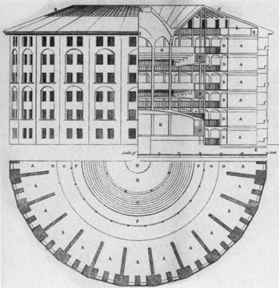
What is a Panopticon?

Slide 11
Has IT Created a Panopticon?
IT has:
  Changed the scale of information collected and stored
    Digital files, MP3 file-compression format, high-volume, cheap digital storage media, scanners (which digitize data)
    Database (DB) approach (vs. the traditional file approach) that collects, stores, retrieves info quickly and cheaply
      Traditional file approach (pre-1990s) stored data unlabeled and uncategorized as a continuous string of bytes with no easy mechanism to locate and manipulate the data (think of the traditional file approach as data storage on a VCR tape)
      DB approach (1980s and 1990s) labels and organizes each piece of digitized data (usually into tables) and provides tools to locate and manipulate data quickly
  Changed the kind of information collected and stored
    Ecommerce: on-line click stream data, on-line search query data
    Workplace: biometric characteristics (e.g., fingerprint scans), keystrokes, work habits, time logged in, email read and sent
    Elsewhere: physical location data
    This is information we never thought about collecting years ago, but IT now enables it

Slide 12
Has IT Created a Panopticon?
IT has:
  Changed the scale of information exchanged and distributed
    WWW, broadband (high-speed) Internet connections, peer-to-peer (P2P) networks vs. client-server architecture
    Easy and quick transmission of stored digital data over the private networks and the Internet
  Magnified the effect of erroneous information
    Once you give up control of your data it is impossible to regain control
    Consider an example
      A pregnant woman decides to register at a Babies-R-Us website to receive baby-related coupons, notices, free samples, and advertisements
      What does Babies-R-Us do with that data? Sells it to 3rd parties (e.g., Gerber’s)
      Assume that the woman has a miscarriage – what is going to happen? She is likely to continue receiving painful reminders on a daily basis! Adverse psychological affects?
      What is the woman notifies Babies-R-Us of the problem? The ads probably continue since her data has been sold to many marketers – it will be difficult to track down all the other lists that she has been added to

Slide 13
Has IT Created a Panopticon?
IT has:
  Enabled the combination (or recombination) and analysis of data
    We can now merge data from different DB (e.g., link financial records, work records, family record, and medical records) to develop much more detailed user profiles of our personal characteristics, activities, opinions, habits, etc.
      Metromail is a data broker that aggregates and maintains a lot of data about over 100 million people in the U.S.
        Specializes in tracking transitions in people’s lives (e.g., moves)
        When you move to a new house, Metromail figures it out and, for 25 cents/name, sells your name and address to junk mailers (furniture stores, cell phone companies, long distance telephone, hardware stores, appliance stores, local restaurants, etc.)
      ChoicePoint is also a data broker
        Maintains data on drug tests, insurance fraud, bankruptcies, public records
        Government and business agencies use it to verify data and credentials for job applicants (i.e., background checks)
    Advances in algorithms (mathematical and statistical methods) and data mining tools have improved our ability to finds patterns in data that we could not see before

Slide 14
Privacy-Invasive Technologies
(Specific Technologies)
IT has:
  Made the invisible collection of personal data without user knowledge easier
    Cookies
      Small text files (with ID number) written and stored on user’s hard drive by a website when the user visits that site with a browser
      Store information about a visitor’s activities (e.g., passwords, a list of pages visited and for how long, dates last examined, what is in your shopping cart, what is in your wish list, the browser you used, IP address, etc.)
      When the user visits again the stored cookie is sent back to the site with all the info
      The cookie interaction can be anonymous (no personal info, only a unique cookie ID), but the anonymous info can be linked to personal info based on purchases or registration on the site
      Help provide data for targeted marketing

Slide 15
Privacy-Invasive Technologies
(Specific Technologies)
IT has:
  Made the invisible collection of personal data without user knowledge easier
    3rd party cookies
      Cookies placed on a network of related sites so that the user can be tracked not just within a single site but anywhere within the network
      DoubleClick (now owned by Google) has deals with tens of thousands of websites and maintains cookies on over 100 million people (linked to lots of data on browsing behaviors)
      ISPs are the ultimate 3rd party cookie (can access your entire navigation history)
    Web beacons (or bugs)
      Embedded as an invisible graphic (sometimes called “clear GIFs”) on a web site or an email in order to track visitors to that website or recipients of the email
      Can count visitors (click rates to pay sites for ad space), track pages visited, get IP address of visitor, the browser used, count # times a banner was opened, etc.
      Can use in email to trigger with an instruction to open an image – this tells the sender that the message was read and how many times it was forwarded (you can’t do this with “snail mail”)

Slide 16
Privacy-Invasive Technologies
(Specific Technologies)
IT has:
  Made the invisible collection of personal data without user knowledge easier
    Spyware
      Much more intrusive methods for collecting online date
      Small computer program installed on your hard drive (usually without your knowledge or consent) that tracks the user’s habits (e.g., all web surfing) and transmits that information to a third party
      Can be malicious (e.g., steal credit card numbers, ID/passwords, or reformat search engine results to put a client’s link at the top of a legitimate search results page)
    In 1999, Comet Systems offered a free software application that allowed users to change their Web browser's cursor into cartoon characters (~16 million people)
      Without user knowledge or consent, the software tracked how many people used the software, their IP addresses, systems information (e.g., browser type), and the sites that they visited
      Article

Slide 17
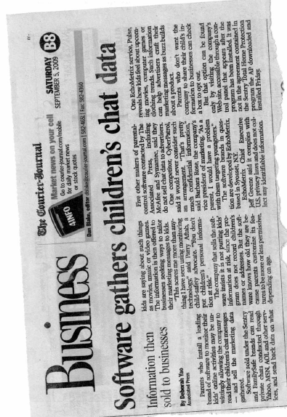

Privacy-Invasive Technologies
(Specific Technologies)

Slide 18
Privacy-Invasive Technologies
(Specific Technologies)
IT has:
  Made the invisible collection of personal data without user knowledge easier
    Are you aware of Event Data Recorders (EDRs) in automobiles?
      Installed in some cars to record information related to vehicle crashes / accidents (~ “black box” in airplanes)
      May record impact speed, brake application, steering angle, sea belt use, airbag deployment, cruise control status, etc.
      On April 12, 2007, N.J. Governor Jon Corzine was seriously injured in an automobile accident – an EDR recorded his SUV travelling at 91 mph (in a 65 mph speed limit zone) 5 seconds before the crash
      How will this data be used in insurance claims and court cases?

Slide 19
Privacy-Invasive Technologies
(Specific Technologies)
Did you know that search engines (e.g., Google.com, Ask.com) collect and store your search query data?
  Search engines collect many terabytes of data daily (cheap to store) and maintain large databases of past user queries. What does Google collect? Search engine log data
    What search terms that you entered
    How many pages of search results that you looked at
    How many search results that you clicked on
    How you refined your search queries
    What spelling errors that you commonly make
    What browser you use
    What your IP address is
    What might this look like?
      Assume you have never visited Google.com and now visit it and search for “cars”
      Google will send a cookie and record something like (notice no personal data)
Inktomi1-Ing.server.ntl.com – 25/Mar/2009 10:15:32 – http://www.google.com/search?q=cars – MSIE 6.0; Windows XP – 740674ce2123e969

Slide 20
Privacy-Invasive Technologies
(Specific Technologies)
Did you know that search engines (e.g., Google.com, Ask.com) collect and store your search query data?
  How is this information used? (see Google Privacy FAQ)
    Google analyzes this data to improve search engine services (better quality result rankings), better targeted advertising, and develop new products/services (e.g., Google Spell Checker)
      DB of queries serves as inputs for testing and evaluating modifications in search engine algorithms used to select and rank search results
      Analysis of query data leads to new services such as “Google Spell Checker”
        Automatically looks at a user’s query and checks to see if the user is using the most common version of the word’s spelling. If Google “calculates” that the user is likely to get more relevant search results with an alternative spelling it will ask “Did you mean: (more common spelling)?”
      The cookie also records the user’s search setting preferences (e.g., settings to see 100 results/page instead of 10 results/page)

Slide 21
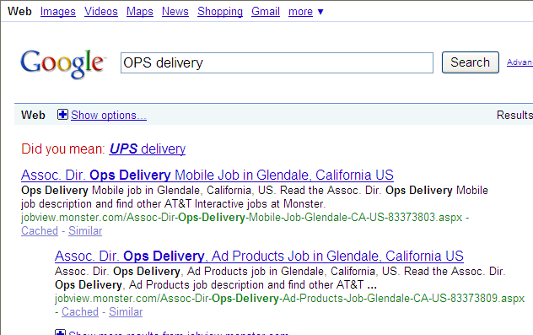
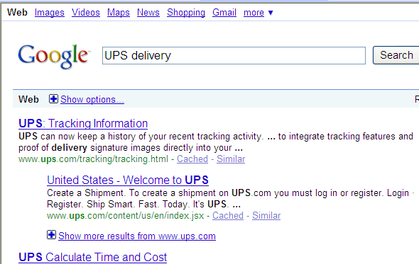
Privacy-Invasive Technologies
(Specific Technologies)
Did you know that search engines (e.g., Google.com, Ask.com) collect and store your search query data?
  “Google Spell Checker”

Slide 22
Privacy-Invasive Technologies
(Specific Technologies)
Did you know that search engines (e.g., Google.com, Ask.com) collect and store your search query data?
  Is this data collect a threat to the users’ privacy?
    But you may still be concerned about maintaining privacy about searches that you make – for example, searches about: health and psychological problems, bankruptcy, alcoholism, erotica, illegal drugs, etc.
    The data collection is basically invisible (i.e., covert) since most people do not know that every one of their searches is collected and stored

Slide 23
Privacy-Invasive Technologies
(Specific Technologies)
Did you know that search engines (e.g., Google.com, Ask.com) collect and store your search query data?
  Is this data collect a threat to the users’ privacy?
    What type of data is not collected with Google searches from the main search page (i.e., when a user is not registered for a Google service)?
      Does not collect personal data (such as name, address, phone number)
        Google just knows (based on a cookie) that a particular software browser on a particular computer made a search
        Google does not know who was sitting at the computer performing searches
        Google claims that your “account cookies” (which have personal data) are not linked with your “search cookies” (which do not have personal data)
        Take note that by registering you do run a more significant privacy risk in the future (i.e., if Google decides to link and combine the cookies)

Slide 24
Privacy-Invasive Technologies
(Specific Technologies)
Did you know that search engines (e.g., Google.com, Ask.com) collect and store your search query data?
  Is this data collect a threat to the users’ privacy?
    Who gets to see this huge mass of data and why should we care?
      The federal government presented Google with a subpoena for 2 months of user search queries and all of the URLs that Google indexes
        At the time the government wanted to respond to court challenges to the Children’s Online Protection Act (COPA)
        This generation lots of protests from users and privacy advocates
        Courts reduced the scope to 50,000 URLs and no user query data
      A few months later, Google posted a huge DB of user search query data for researchers to access
        >20 million searches by ~650,000 people over a 3-month period
        Data identified by coded ID #, not by name or IP address
        Re-identification problem: The ability to deduce the identity of some people from “anonymous” data
        Journalists and others were able to identify some people from small towns based on specific topics searched (e.g., their own names/addresses, their cars, their health problems)
        Once identified, that person may be linked with all his other searches

Slide 25
Privacy-Invasive Technologies
(Specific Technologies)
Did you know that search engines (e.g., Google.com, Ask.com) collect and store your search query data?
  What are the lessons?
    Anything we do online is recorded and linked to our computer (and maybe our name)
    Huge amounts of data are stored with new storage devices
    Data collection is often covert (without your knowledge and consent)
    Leaks happen
    A collection of many small items of information can give a fairly detailed picture of what a person’s like
    Direct association with a person’s name is not essential for compromising privacy (i.e., re-identification)
    The government sometimes requests sensitive, personal data held by a company
    Data on the Internet and stored in DB seem to last forever
    It is extremely likely that data collected for one purpose will be used for another purpose (secondary uses)
    We cannot protect all data ourselves – we must depend on the company’s that have it to protect it from thieves, accidental leaks, and a prying government

Slide 26
Privacy-Invasive Technologies
(“Big Brother” is Watching)
Basis of privacy rights → 4th Amendment of the Bill of Rights
  Protects people from unreasonable search and seizure by the government
  Requires probable cause to get a warrant for a search and a specification of the place to be search and what will be seized
“Big Brother” = Government
  George Orwell’s 1984: The government could watch everyone via “telescreens” in all homes and public places
    Little crime, little political dissent, and little love or freedom
  Minority Report (2002 movie with Tom Cruise)
    Similar idea except law enforcement used psychics (precogs - mutated humans with precognition abilities) to monitor people’s thoughts and arrest people pre-crime (i.e., before they commit a crime!)

Slide 27
Privacy-Invasive Technologies
(“Big Brother” is Watching)
Government DBs
  Government agencies maintain 1000s of DB containing personal data
    Tax records, medical records (Medicare, Medicaid, military), marriage/divorce records, school records, property ownership, welfare (with family details), motor vehicle records, voter registration records, books checked out in public libraries, people with firearm permits, applications for government loans and grants, bankruptcy records, arrest records, and you get the idea!
    The government collects information (e.g., surveillance data related to the “war on terrorism”), requests it from businesses, gets court orders to collect data, buys personal information from resellers, etc.
    Helps government perform its functions
      Determine eligibility for federal programs and government jobs and benefits, detect fraud in government programs, collect taxes, catch people who break the law, etc.
    So what is the problem?
      Government has a ton of personal data and the power to arrest people and seize assets
      The potential misuse of personal data by government poses a special threat to liberty and privacy

Slide 28
Privacy-Invasive Technologies
(“Big Brother” is Watching)
Government DBs
  Government agencies maintain 1000s of DB containing personal data
    So what is the problem? Consider the IRS and taxpayer data!
      Each year hundreds of IRS employees are investigated for snooping into people’s tax files
        Example: An IRS employee who was a KKK member read tax records for his KKK group to look for income information that would indicate a member was actually an undercover agent
      IRS employees dispose of discs with sensitive taxpayer data without erasing files
      Tax data is at risk from hackers and disgruntled employees because many of the 250 + federal agencies to which the IRS provides taxpayer info do not have adequate data protections
    So what is the problem? Consider the expansion of government DB over time
      CODIS = FBI DNA DB
        Originally only contained DNA of convicted sex offenders
        Now contains data collected from crimes scenes, other classes of criminals (e.g., murders, misdemeanors), people arrested for a crime

Slide 29
Privacy-Invasive Technologies
(“Big Brother” is Watching)
Government DBs
  Government agencies maintain 1000s of DB containing personal data
    So what is the problem? Consider the proposal for a government DB to track college students
      Department of Education proposed establishing a DB to contain records of every student enrolled in a college or university in the U.S.
      Universities would be required to provide and regularly update records including student’s name, gender, SSN, major, degrees, loans, scholarships, courses taken, courses passed, etc.
      Benefits
        Good way to track success of govt student loan/scholarship programs
        More accurate information on graduation rates and college costs
        Better able to track the # of future nurses, engineers, etc. to improve the effectiveness of immigration policy and business planning
      Privacy risks?

Slide 30
Privacy-Invasive Technologies
(“Big Brother” is Watching)
Automated toll collection systems
  Used at many bridges, tunnels, and toll roads
  Sensors read devices in the car as it goes by without stopping and the owner’s credit card or bank account is billed for the toll
  Benefits
    Saves time and lowers collection costs (i.e., fewer human toll operators)
  Privacy Risks?
    Toll DB now contains a record of when/where a person travelled (and sometimes how fast)
    Can marketers and government agencies use this information to track people?
      NY judge ruled that police can access toll records without a court order because traffic movement is in public view and drivers should not have the expectation of privacy regarding their travel (not protected by 4th Amendment)
        But without these detailed systems travel is basically anonymous
      Does this mean that law enforcement should also be able to access a list of books that you buy at Barnes & Noble without a court order since your purchase is in public view?

Slide 31
Privacy-Invasive Technologies
(“Big Brother” is Watching)
Satellite imaging
  Use of technology to take detailed photographs of earth
    May show homes and backyards
  State governments may use this technology to
    Catch people who are growing illegal drugs
    Detect buildings or property improvements that may lead to higher property taxes
    Catch people who have built backyard porches without the required building permits
  Are such “noninvasive but deeply revealing” searches a privacy invasion that the 4th Amendment should prohibit?

Slide 32
Privacy-Invasive Technologies
(“Big Brother” is Watching)
Backscatter technology
  Transportation Security Administration (TSA) uses a new kind of x-ray machine at some airports that displays a (sometimes revealing) computer image of a person’s body and any weapons or drug packets hidden under the clothes or a wig (no need for physical contact)
    First implemented in Phoenix Airport in 2007 with new tests now going on at Houston’s George Bush International Airport and Greater Rochester International Airport
    ACLU has call this a virtual strip search
  What are the usage policies for this technology so far?
    TSA “blurs out” certain body parts (and use of cloakers)
    TSA claims that the technology cannot save, print, or transmit images
    Usage is voluntary → the person has the choice of using the backscatter technology or undergoing a pat-down search (which is slower, less thorough, and more physically intrusive)
    The security officer who assists the passenger through the screening process never sees the image the technology produces. Instead, the image is viewed by a remotely located security officer who never sees the traveler

Slide 33
Privacy-Invasive Technologies
(“Big Brother” is Watching)
Video surveillance
  Security cameras at banks, convenience stores, casinos, and prisons
  2001 Super Bowl (aka Snooper Bowl) in Tampa, Fl
    Used technology to scan the faces of all 100,000 fans and employees who entered
    The system used facial-recognition software to compare the facial geometry of each person with a DB of known criminals – trying to find matches
  Tampa, Fl installed a similar facial-recognition video surveillance system in a neighborhood with lots of restaurants and nightclubs
    Police in a control room would zoom in on faces and check for matches in their DB of suspects
    In 2 years the systems did not recognize any suspects but did occasionally identify an innocent person as a wanted suspect
    They stopped using it (accuracy was not good enough)
  Traffic monitoring system in another city in Fl
    Removed after engineers were found zooming in on individual pedestrians unrelated to traffic flow
  More police patrols/increased lighting may better deter crime

Slide 34
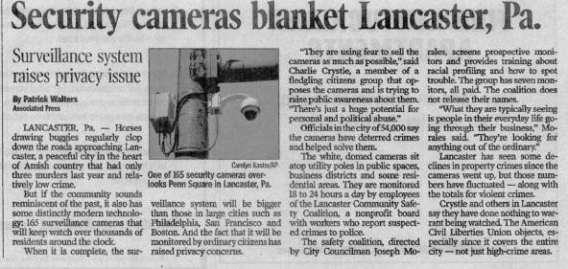
Privacy-Invasive Technologies
(“Big Brother” is Watching)
Video surveillance

Slide 35
Privacy-Invasive Technologies
(“Big Brother” is Watching)
Location tracking systems
  Computer and communications services that depend on knowing exactly where a person (or object) is located at a particular time
    Global Positioning Systems (GPS), cell phones
    Radio Frequency Identification (RFID) tags
      Small devices that contain a computer chip and an antenna
      Antenna transmits and receives radio signals for communicating with devices that read the tag
      Inserted in many objects to track them through manufacturing and distribution
      Government has proposals to embed RFID tags in various documents such as passports (although there are still a lot of security issues with RFID)
    Track pets, children, people with Alzheimer’s disease
    Some schools have even proposed removable tracking devices for students
      What do you think parents and students think of this idea?
    How do we protect ourselves from thieves, nosy neighbors, stalkers, divorce lawyers, people who object to our religion, politics, lifestyle, etc.?

Slide 36
How Can We Protect Our Privacy?
How can we gain some semblance of control over this personal information?
  Social norms-based solutions (privacy policies, consumer education)
    Allow the companies to self-regulate (may be likely to do so in order to avoid oppressive government intervention)
  Technology-based solutions (encryption, cookies cutters, anonymizers)
  Market-based solutions (privacy policies, consumer demands)
  Legal protections (U.S. vs. Europe)

Slide 37
Fair Information Practices
(What Should Firm Privacy Policies Look Like?)
Notice (awareness)
  What data is being collected?
    Inform people when personally identifiable information about them is collected
    Only collect data that is needed to perform the task
  How is the data collected?
    Cookies? Spyware? Web beacons? Surveys?
  What is the data usage policy?
    Identify specifically what the data will be used for (e.g., completing a purchase, providing customized product offerings, secondary uses, etc.)?
    Develop policies to destroy records that are old or no longer needed
Choice (informed consent)
  Give users some control over secondary uses of their data
    Opt-out options
      Consumer is notified upon collection that his personal information will be used for secondary purposes unless he disapproves and notifies the company
      Offer people a way to opt out from mailing lists, advertising, transfer of data to other parties, and other secondary uses of data (i.e., uses not specified during collection)
      e.g., consumer can click a box on an agreement to request that their information not be used in a particular way

Slide 38
Fair Information Practices
(What Should Firm Privacy Policies Look Like?)
Choice (informed consent)
  Give users some control over secondary uses of their data
    Opt-in options
      Consumer must explicitly approve each secondary use (i.e., a use other than specified during collection or as required by a contract) of his personal information
        e.g., with opt-in, if you fill out a bank loan application and provide credit data the bank cannot sell that data to a marketing company without your explicit permission
      Provides stronger protection for sensitive data (e.g., disclosure of medical data)
Integrity (security)
  Provide protections and safeguard from data theft or modification, unauthorized access, accidental leaks, or other disclosures
Access (participation)
  Provide a way for people to review/access personal information, challenge its correctness, and have it changed
Enforcement (redress)
  Compliance verification, dispute resolution, and remedy

Slide 39
Fair Information Practices
(What Should Firm Privacy Policies Look Like?)
Develop policies for responding to law enforcement requests for data (announce it and follow it)
  Some companies give up data to law enforcement and government agencies upon request
  Some companies give up data when served with a subpoena or court order
  Some challenge the court orders
  Some inform consumers when they give personal data to law enforcement and government agencies
Note the limitations of these Fair Information Practices
  These principles primarily address privacy issues related to large DBs of businesses and government
  These principles do not do much to address the use of public video surveillance or when individuals supply huge amounts of personal data about themselves to the public (e.g., via MySpace or Facebook)

Slide 40
Fair Information Practices
(What Should Firm Privacy Policies Look Like?)
Let’s reconsider Google’s Search Query DB again
  Privacy advocates want to prevent collection and storage that allows identification or re-identification
  If a user does not register or subscribe to some service of Google.com he has not viewed or accepted Google’s privacy and information sharing policies (i.e., there is not informed consent)
  People use Google.com and other search engines without registering
  So what should Google do to remain consistent with the Fair Information Practices?
    Since there is no agreement and most people do not expect search query data to be collected and users may expect a privacy-protecting default that specifies that Google will not store or use the data beyond the purposes of the search in a way that can disclose a person’s search data
    Or should the expectation that by using a free search tool you have given Google consent to collect and use the data for secondary purposes?
    No matter what Google should provide a clear and visible link to its privacy policy regarding collect and use of search query data

Slide 41
Fair Information Practices
(What Should Firm Privacy Policies Look Like?)
Examples of Privacy Policies consistent with the Fair Info Practices
  Google.com
    Google Privacy Center
    Google Privacy Policy
    Interesting note in Google’s Privacy FAQs
      Question: I have targeted ads on Gmail – is someone actually looking at what I write to match the ads with my emails?
      Response: “Like most email services, Gmail uses software to scan emails for viruses and to filter out spam. Google uses this same kind of software to scan for keywords in users’ emails which we can then use to match ads. When a user opens an email message, computers scan the text and then instantaneously display relevant information that is matched to the text of the message. Once the message is closed, ads are no longer displayed. The whole process is automated and involves no humans.”
  Amazon.com
    Amazon.com Privacy Notice
  Walmart.com
    Walmart.com Privacy Policy

Slide 42
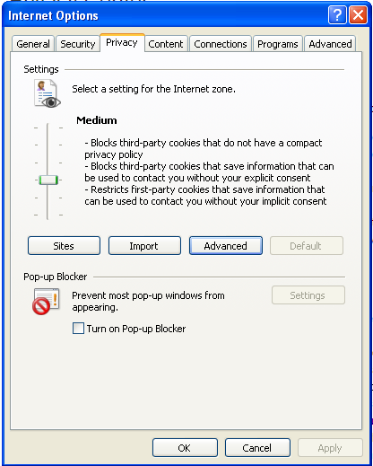
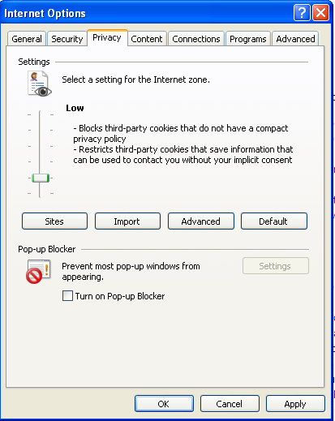
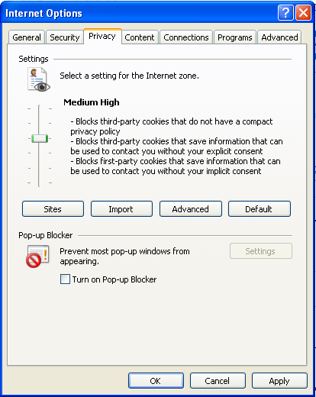
Technology-Based Solutions
Data encryption
  We will discuss this during “Computer Crimes and Security”
Cookie cutters
  Utility programs (usually free) that prevent web browsers from exchanging cookies with web sites
  Web browsers have the capability to deal with cookies (uses P3P)

Slide 43
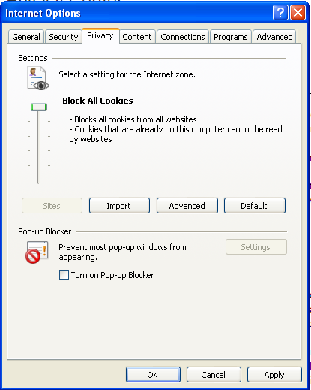
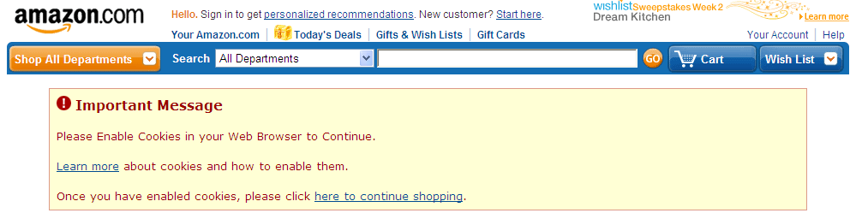
Technology-Based Solutions
Cookie cutters

Slide 44
Technology-Based Solutions
Anonymous remailers
  Tools and services designed to help individuals surf the web or send email anonymously (no link to IP address)
  Some services rely on a series of trusted third-parties that strip off identifying information and forward requests on behalf of a user
  Not much use if you need to perform transactions in which personal information must be revealed
  Anonymizer (www.anonymizer.com)
    Anonymous web browsing program that does not accept cookies and hides your IP address so that people cannot track your surfing or build profiles
    Redirects your web surfing through their server which has 128-bit Secure Sockets Layer (SSL) technology, similar to that of your bank
P3P and identity managers
  Platform for Privacy Preferences (P3P)
  http://www.w3.org/TR/P3P/
Automated privacy audits

Slide 45
Marketplace Solutions
Pressure from customers and competitor
  Privacy policies (firm-level)
  Is this enough?
  Are consumers sufficiently informed on the issue to take decisive action? Are they sufficient energized about the issue of privacy?
  What about enforcement?
What else can consumers do?
  Stop putting so much personal data (e.g., contact information, pictures) on blogs and social-networking sites
    Especially data that may cause problems with parents, future employers, and law enforcement
    By sharing our data with outside companies and entities we put ourselves at risk
  Be aware, find and read privacy policies, and make informed decisions
  Is there a generational difference? Is it that young people do not care about privacy or is it that they do not sufficiently understand the risks?

Slide 46
Social Norms-Based Solutions
Third party enforcement programs
  Online Privacy Alliance (http://www.privacyalliance.org/ )
  Network Advertising Initiative (http://www.networkadvertising.org/)
  Direct Marketing Association (DMA) (http://www.the-dma.org/privacy/creating.shtml)
    The DMA's Privacy Policy Generator
  Privacy seal programs
    TRUSTe (http://truste.org)
    BBB Online (http://www.bbbonline.org)

Slide 47
Law Solutions
(U.S. Approach)
Reactive, piecemeal legislative acts in U.S.
  Fair Credit Reporting Act (1970)
  Right to Financial Privacy Act (1978)
  Cable Communications Policy Act (1984)
  Video Privacy Protection Act (1988)
  Driver Privacy Protection Act (1994)
  Children’s Online Privacy Protection Act (1998)
    Examples: BonziBuddy and UMG Recordings
  Gramm-Leach-Bliley Act (1999)
  Health Insurance Portability and Accountability Act (HIPAA) (2001)
  Genetic Privacy Legislation (state regulations)

Slide 48
Law Solutions
(European Comprehensive Approach)
Europe sees privacy as “data protection” and as a “basic human right”
Data Protection Directive: Directive 95/46/EC
  Sets forth Fair Information Principles the EU members must implement in their own laws
  The protection of individuals with regard to:
    Processing of personal data and
    The free movement of such data (between companies)
  Customers must be notified of the collection and use of data about them
  Personal data may be collected and used only for the explicit purpose specified and must not be processed for incompatible uses (i.e., no secondary uses without explicit consent of the customer)
  Data must be accurate, up-to-date, and not kept longer than necessary
  Can only process data with customer consent (opt-in requirement) unless processing is necessary to fulfill contractual obligations (or if processing is necessary for tasks in the public interest)

Slide 49
Law Solutions
(European Comprehensive Approach)
Data Protection Directive: Directive 95/46/EC
  Companies cannot process sensitive data (racial/ethnic origins, political/religious beliefs, health and sex life issues) at all without explicit customer consent
    Processing of data about criminal convictions is severely restricted
  Customers have the right to see the processes and to access and correct their data
  Accountability (bureaucratic infrastructure to monitor compliance)
    Requires firm-level data controller
      Responsible for processing data, registering with govt, and contacting government before processing
        Purpose, description of data subjects, those who may receive the data, proposed transfer to third countries, and assurance of security and legitimacy of processing
    Requires a dedicated government (national) privacy agency
      Firms must register DB with the agency and may need to get prior approval before processing personal information
      Investigates data processing activities and monitors application of Directive
      Intervenes to ban processing of data or to destroy data
      Authorized to hear and resolve complaints from data subjects
    Requires legal framework for courts to follow
  Onward Transfer: European firms cannot give customer information to any firm in any country that does not have the same level of protection as set under the directive

Slide 50
Law Solutions
(European Comprehensive Approach)
What are the downsides of such comprehensive regulations?
  Costs to firms of compliance
  Costs to firms and government of monitoring and enforcement
  Legal costs
  Who protects companies from the government invading its right to privacy? (Big Brother vs. Little Brother)
    There do not seem to be restrictions on the processing of data by government agencies
    European governments actually require ISPs and telephone companies to retain customer records for up to two years and to make them available to law enforcement agencies (says it is need to fight terrorism and organized crime)
    I guess “Big Brother” knows best!
  May hinder e-commerce transactions between European and U.S companies (i.e., the onward transfer requirement)
  Enforcement has been relatively weak to this point
    However, at least people have legal recourse to protect their privacy

Slide 51
Safe Harbor Program
Provides way for U.S. companies to comply with the European Data Protection Directive
  July 2000
  List of participants (http://www.export.gov/safeharbor/)
  Companies outside of the EU that agree to abide by a set of privacy requirements similar to the Data Protection Directive may receive personal data from the EU companies
Principles
  Notice, Choice, Sensitive information (opt-in requirement)
  Onward Transfer
    can only give info to firms that have same level of privacy protection
  Security, Data integrity, Access, Enforcement
  No requirement for national agency or data controller for Safe Harbor participants
Interesting observation
  2001 study by Consumers International found that only 20% of European websites did comply with the requirement that websites provide an opt-out option while 60% of the most popular U.S. websites offered an opt-out option

Slide 52
Privacy Protection
(European Comprehensive Laws)
E-Privacy Directive: Directive 2002/58/EC
  Specific data privacy rules for the e-communications sector
  Controls on sending SPAM by email, fax, and automated calling machines
    Can only be sent to individuals if sender has received “prior consent” to use contact details to send electronic marketing communications (more relaxed if individual is existing customer)
    Must clearly identify message as SPAM and offer opt-out option
    Must respect opt-out registers
  Rules on the use of cookies by website operators
    Can use without “prior consent” but must provide clear and comprehensive reasons and explanation of what information will be stored on user’s computer
    Must give right to refuse cookies
  General data retention rules
    Must be erased or anonymized when no longer needed for intended purpose

Slide 53
Rationale for Comprehensive Laws by Europe
To remedy past injustices
To promote electronic commerce
To ensure laws are consistent with Pan-European laws

Slide 54
Europe vs. U.S.
European prescription for privacy
  Comprehensive laws
U.S. prescription for privacy
  Legislation for sensitive data
    e.g., HIPAA, Children’s Online Privacy Protection Act, Gramm-Leach-Bliley Act
  Industry self-regulation with technology support for click stream / purchase data
    P3P, audits, privacy seal programs, anonymous remailers, cookie cutters, etc.

Slide 55
Example
Students who live in a dormitory on a college campus are given cards with a magnetic strip that opens the front door of the dorm. Students are not told that each card contains the individual student identifier and that a record of each use of the card is stored.
  What are the possible good purposes of such record keeping?
  Is it right?
  Is it OK if students are told?
  Give arguments and examples to support your answers

Slide 56
Example
You are the CPO of a midsized manufacturing company, with sales of more than $250 million per year and almost $50 million from Internet-based sales. You have been challenged by the VP of sales to change the company’s Web site data privacy policy from an opt in policy to an opt out policy and to allow the sale of customer data to other companies. The VP estimates that his change will bring in at least $5 million per year in added revenue with little additional expense. How would you respond to this request?

Slide 57
Summary
We have a right to privacy
IT invades that right
How do we protect it?
  Technology and education (consumer awareness and action)
  Privacy policies (firm, marketplace)
  Privacy norms (industry self-regulation)
  Laws (government)

